Slide 1
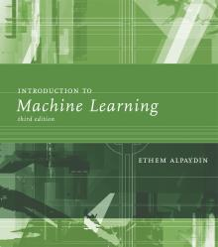
INTRODUCTION TO Machine Learning 3rd Edition
Lecture Slides for
ETHEM ALPAYDIN
© The MIT Press, 2014
alpaydin@boun.edu.tr
http://www.cmpe.boun.edu.tr/~ethem/i2ml3e

Slide 2
CHAPTER 18: Reinforcement Learning

Slide 3
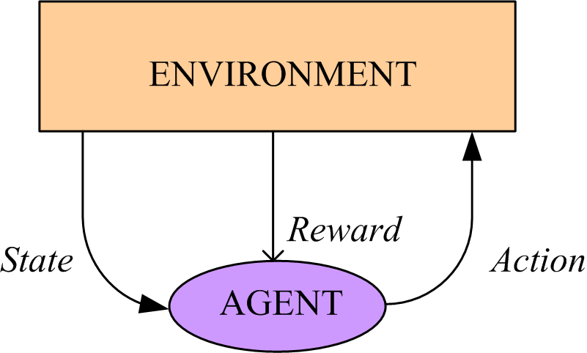
Introduction
Game-playing: Sequence of moves to win a game
Robot in a maze: Sequence of actions to find a goal
Agent has a state in an environment, takes an action and sometimes receives reward and the state changes
Credit-assignment
Learn a policy

Slide 4
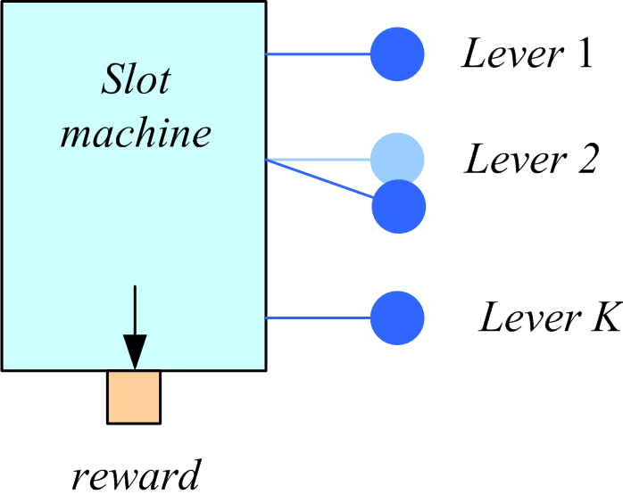
Single State: K-armed Bandit
Among K levers, choose
the one that pays best
Q(a): value of action a
Reward is r_{a}
Set Q(a) = r_{a}
Choose a* if
Q(a*)=max_{a} Q(a)
Rewards stochastic (keep an expected reward):

Slide 5
Elements of RL (Markov Decision Processes)
s_{t} : State of agent at time t
a_{t}: Action taken at time t
In s_{t}, action a_{t} is taken, clock ticks and reward r_{t+1} is received and state changes to s_{t+1}
Next state prob: P (s_{t+1} | s_{t} , a_{t} )
Reward prob: p (r_{t+1} | s_{t} , a_{t} )
Initial state(s), goal state(s)
Episode (trial) of actions from initial state to goal
(Sutton and Barto, 1998; Kaelbling et al., 1996)

Slide 6
Policy and Cumulative Reward
Policy,
Value of a policy,
Finite-horizon:
Infinite horizon:

Slide 7
Bellman’s equation

Slide 8
Model-Based Learning
Environment, P (s_{t+1} | s_{t} , a_{t} ), p (r_{t+1} | s_{t} , a_{t} ) known
There is no need for exploration
Can be solved using dynamic programming
Solve for
Optimal policy

Slide 9
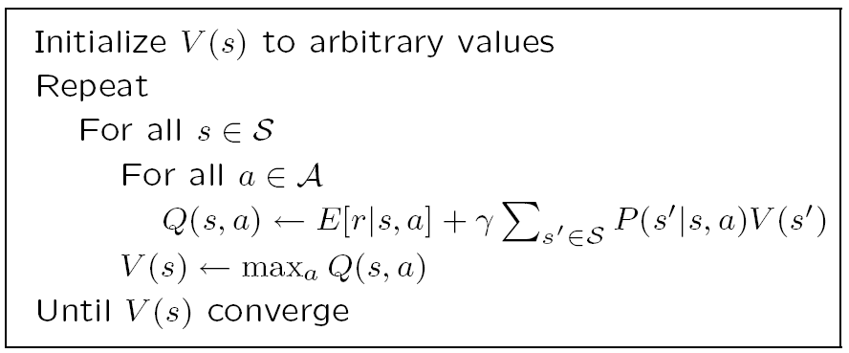
Value Iteration

Slide 10
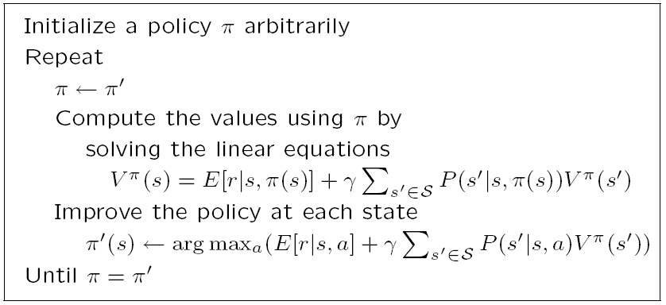
Policy Iteration

Slide 11
Temporal Difference Learning
Environment, P (s_{t+1} | s_{t} , a_{t} ), p (r_{t+1} | s_{t} , a_{t} ), is not known; model-free learning
There is need for exploration to sample from
P (s_{t+1} | s_{t} , a_{t} ) and p (r_{t+1} | s_{t} , a_{t} )
Use the reward received in the next time step to update the value of current state (action)
The temporal difference between the value of the current action and the value discounted from the next state

Slide 12
Exploration Strategies
ε-greedy: With pr ε,choose one action at random uniformly; and choose the best action with pr 1-ε
Probabilistic:
Move smoothly from exploration/exploitation.
Decrease ε
Annealing

Slide 13
Deterministic Rewards and Actions
Deterministic: single possible reward and next state
used as an update rule (backup)
Starting at zero, Q values increase, never decrease

Slide 14
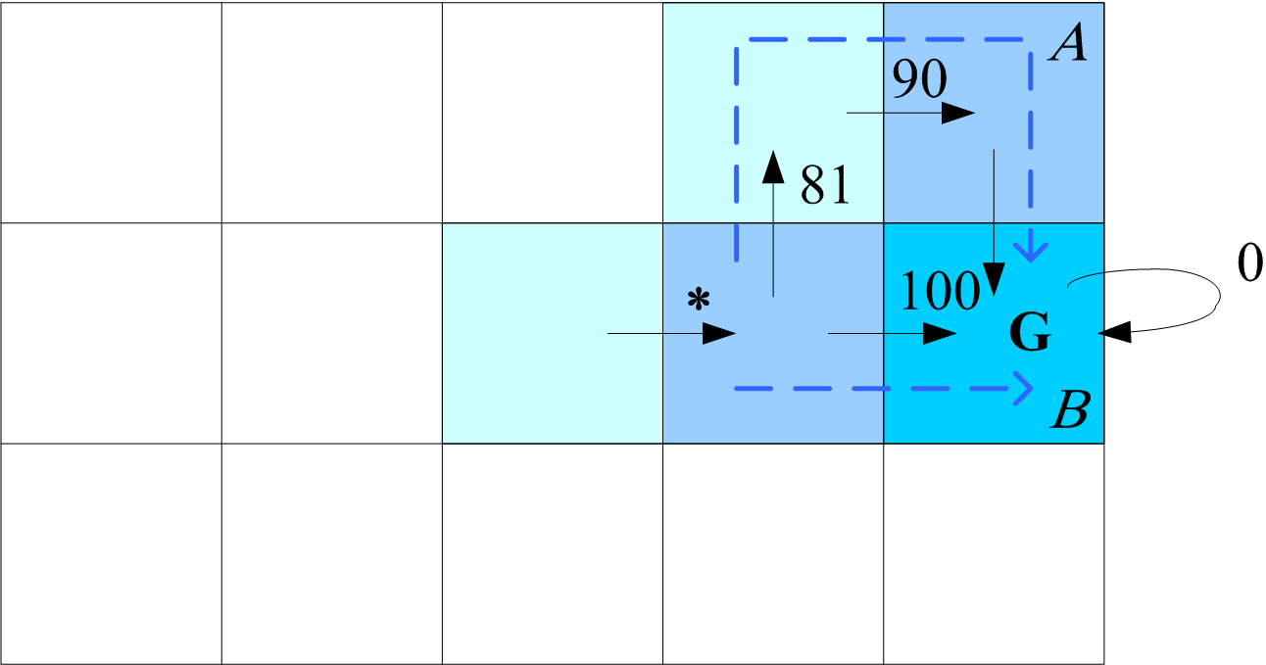
γ=0.9
Consider the value of action marked by ‘*’:
If path A is seen first, Q(*)=0.9*max(0,81)=73
Then B is seen, Q(*)=0.9*max(100,81)=90
Or,
If path B is seen first, Q(*)=0.9*max(100,0)=90
Then A is seen, Q(*)=0.9*max(100,81)=90
Q values increase but never decrease

Slide 15
Nondeterministic Rewards and Actions
When next states and rewards are nondeterministic (there is an opponent or randomness in the environment), we keep averages (expected values) instead as assignments
Q-learning (Watkins and Dayan, 1992):
Off-policy vs on-policy (Sarsa)
Learning V (TD-learning: Sutton, 1988)
backup

Slide 16
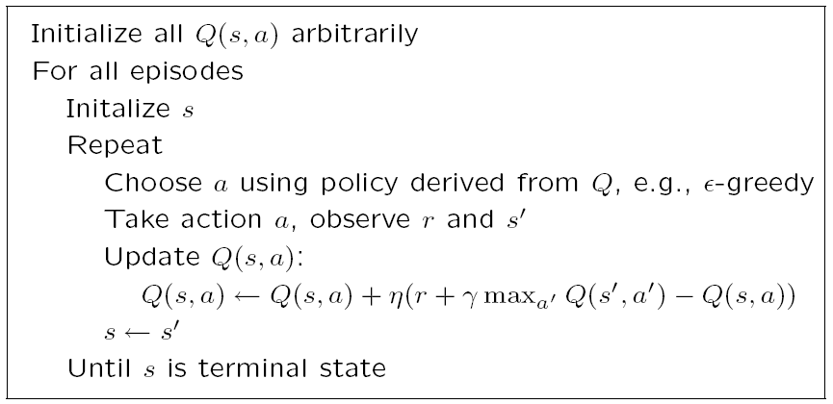
Q-learning

Slide 17
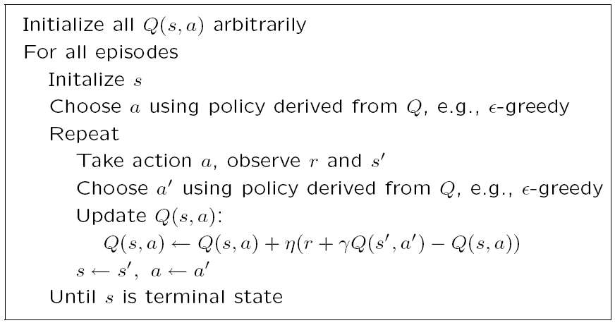
Sarsa

Slide 18
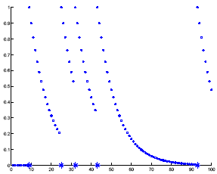
Eligibility Traces
Keep a record of previously visited states (actions)

Slide 19
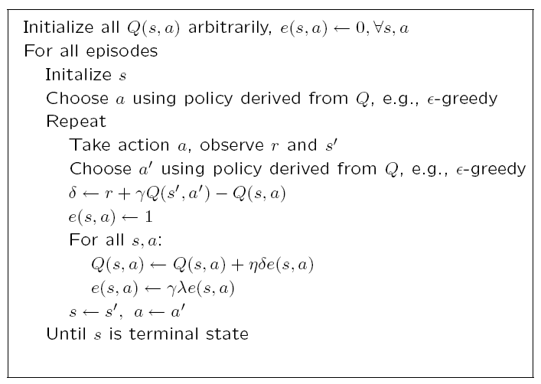
Sarsa (λ)

Slide 20
Generalization
Tabular: Q (s , a) or V (s) stored in a table
Regressor: Use a learner to estimate Q(s,a) or V(s)

Slide 21
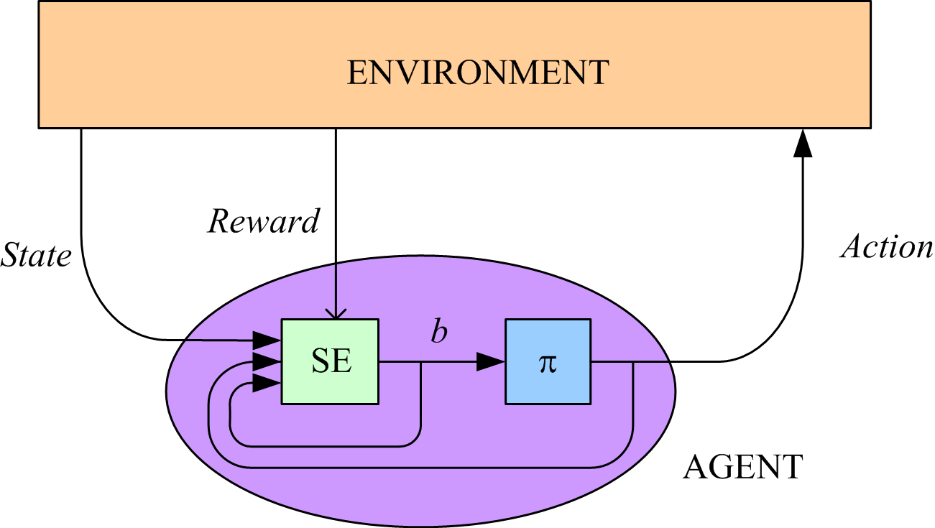
Partially Observable States
The agent does not know its state but receives an observation p(o_{t+1}|s_{t},a_{t}) which can be used to infer a belief about states
Partially observable
MDP

Slide 22
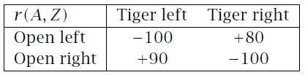

The Tiger Problem
Two doors, behind one of which there is a tiger
p: prob that tiger is behind the left door
R(a_{L})=-100p+80(1-p), R(a_{R})=90p-100(1-p)
We can sense with a reward of R(a_{S})=-1
We have unreliable sensors

Slide 23
If we sense o_{L}, our belief in tiger’s position changes

Slide 25
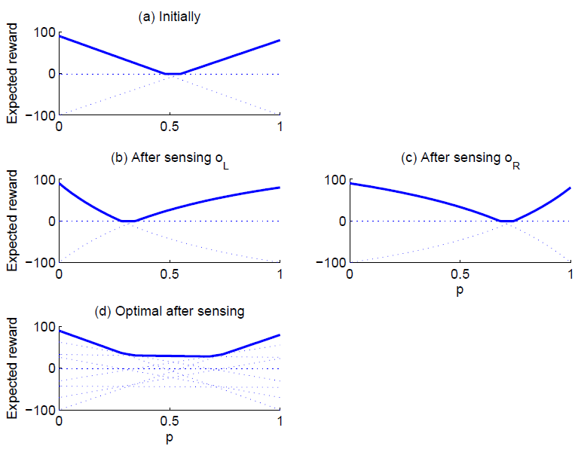

Slide 26
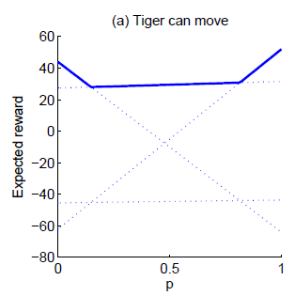
Let us say the tiger can move from one room to the other with prob 0.8

Slide 27
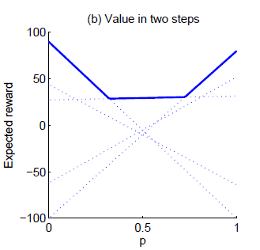
When planning for episodes of two, we can take a_{L}, a_{R}, or sense and wait:

